Slide 1
Speaking Guide
By juel

Slide 2
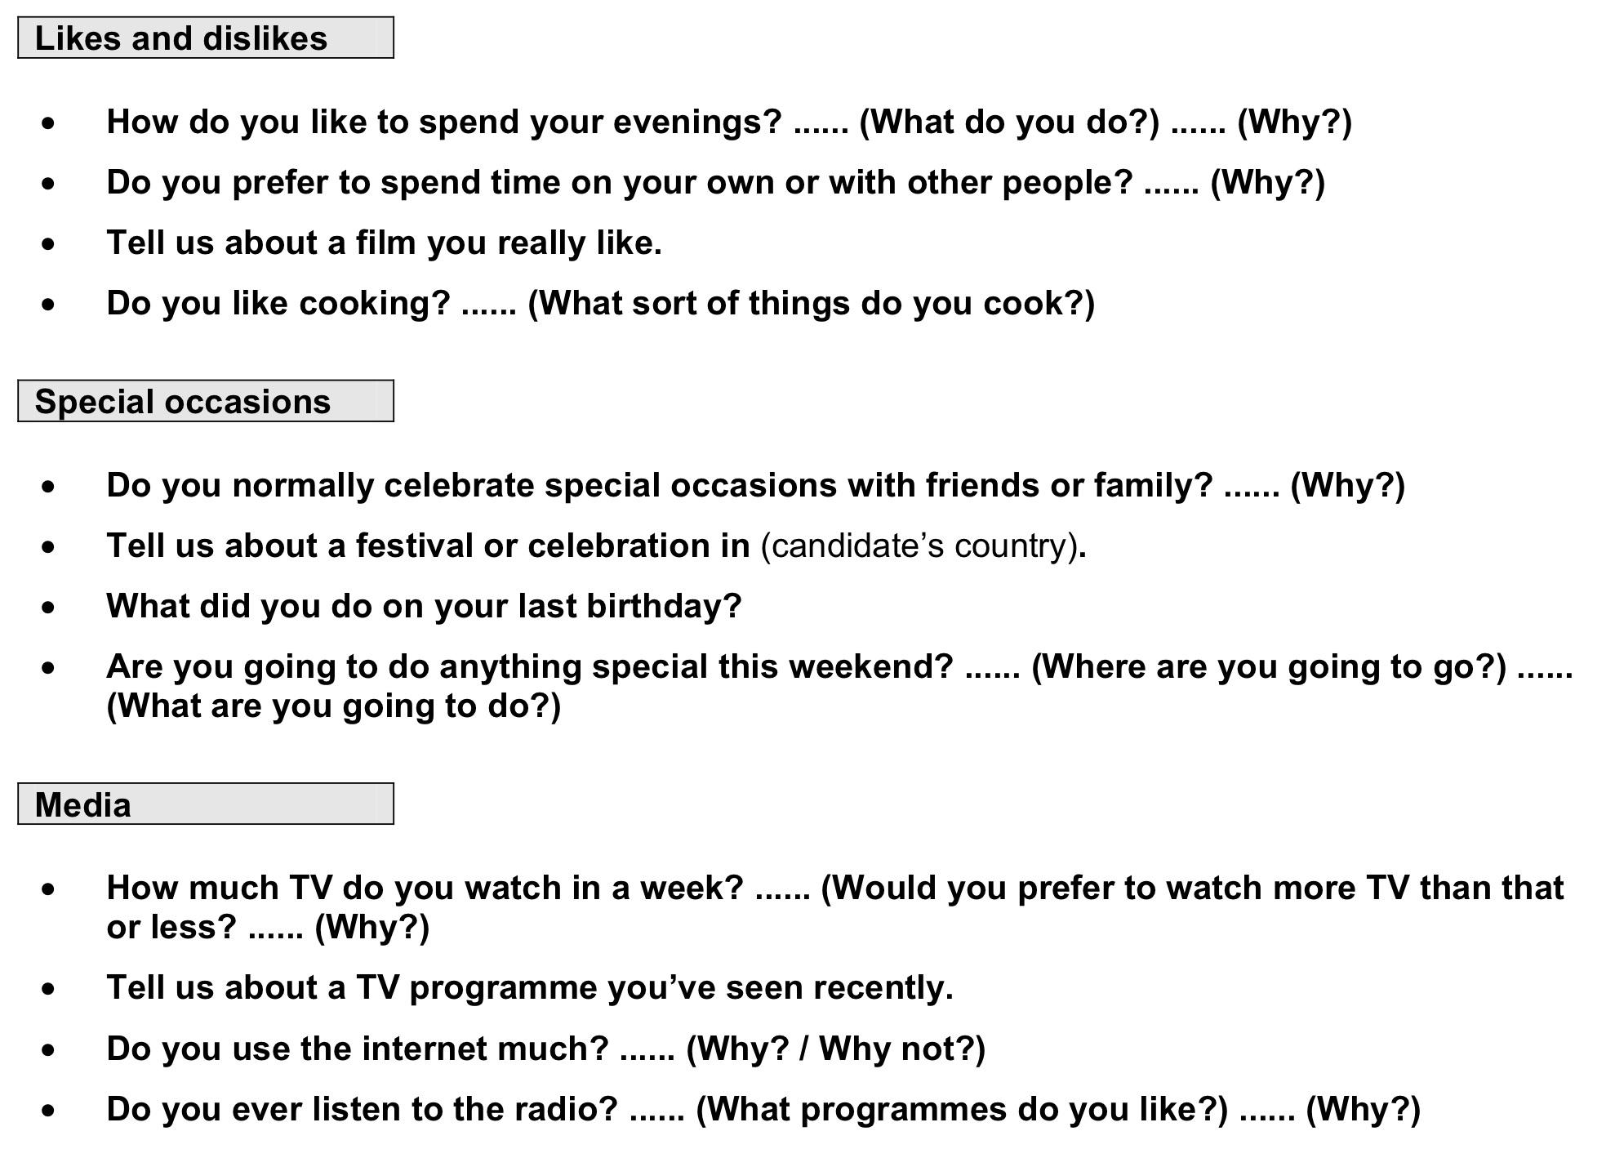
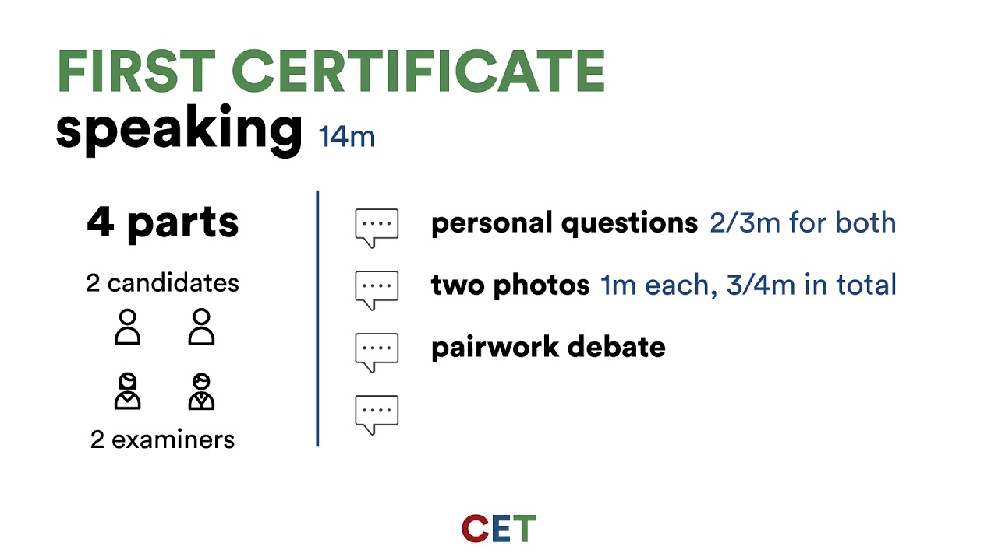
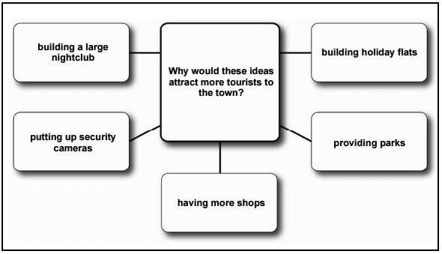
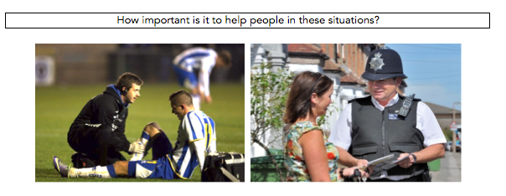
Speaking Parts
PART 1
Deeper questions based on the topic in PART 3
4 minutes
PART2
PART 3
3 photos in CAE

Slide 3
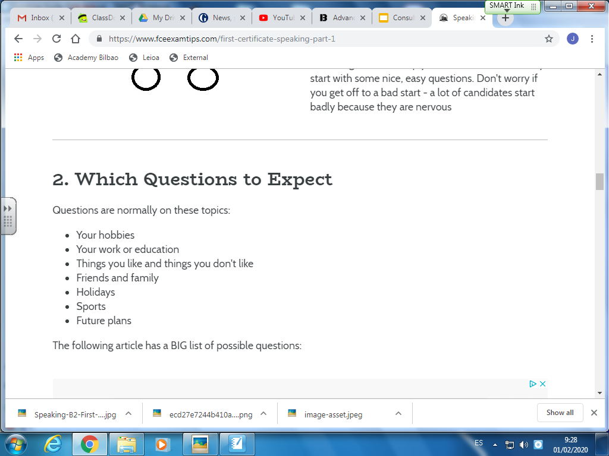
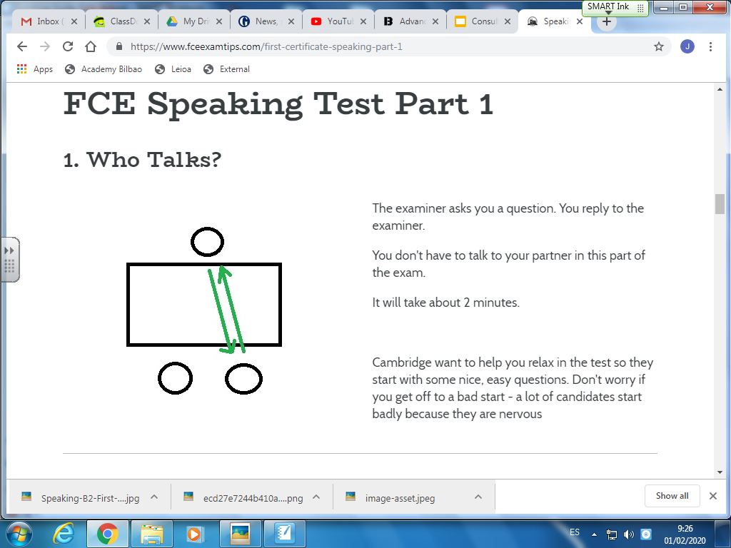
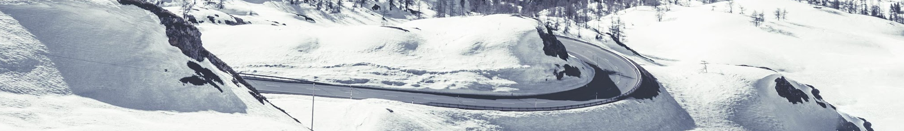
Overview
PART 1

Slide 4
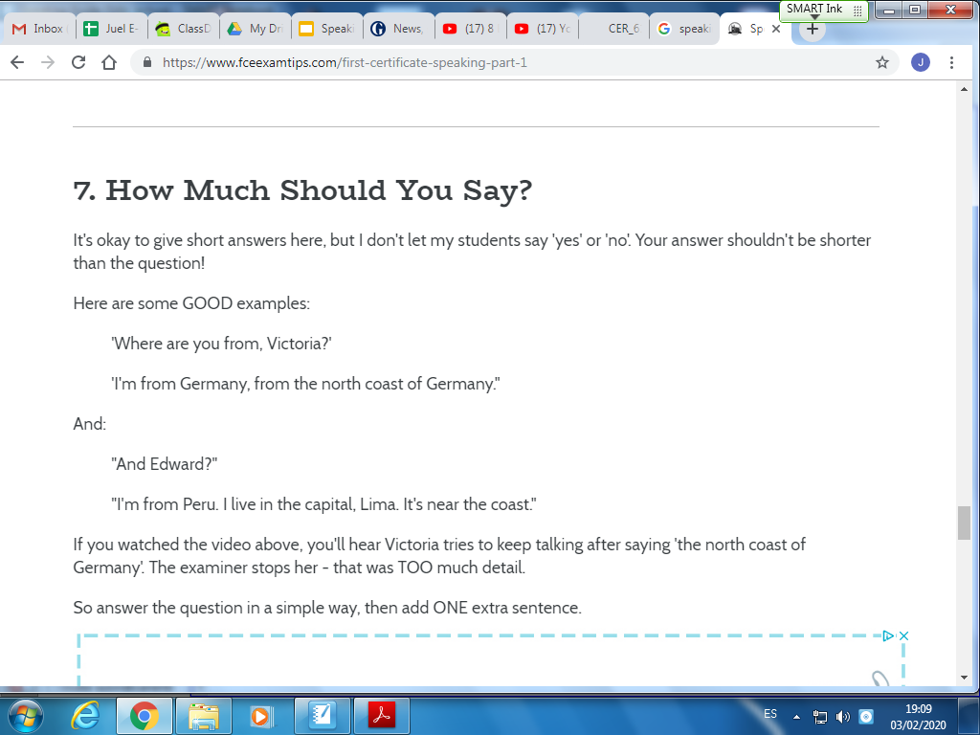
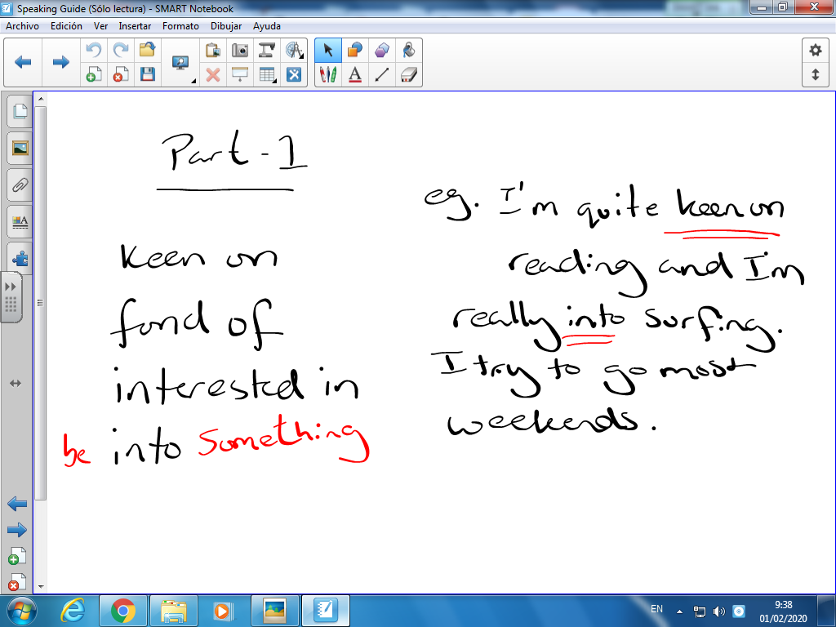
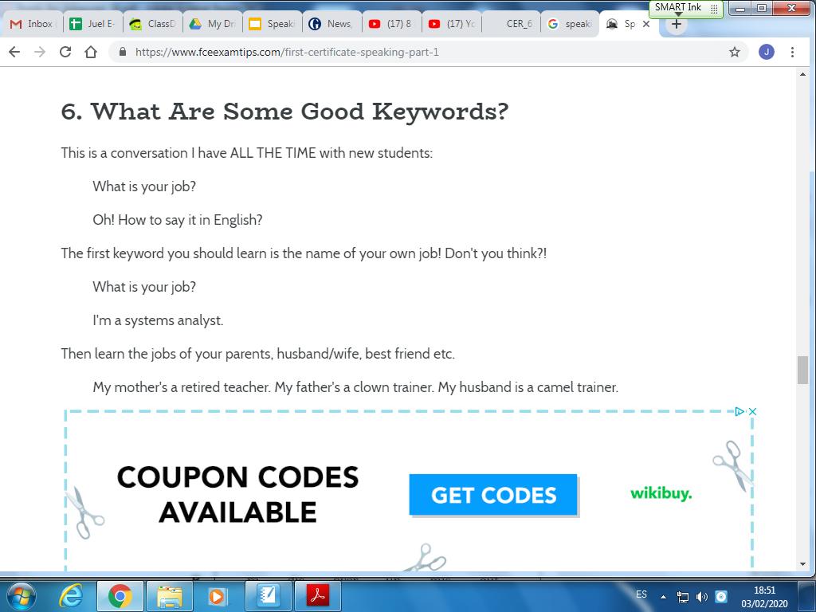
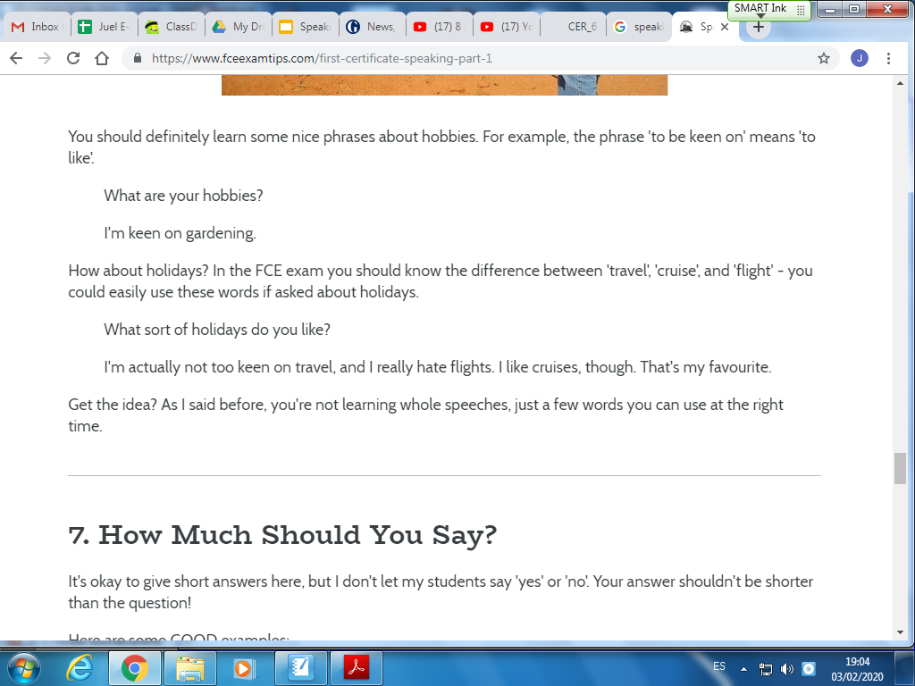
Language to use
PART 1
Keen on
Interested in
Can you tell me about your hobbies.
1
3
2
Fond of
4
Be INTO something
Not too much detail
You should know how to describe yourself and life, what´s your favourite subject etc. and how to pronounce them.

Slide 5
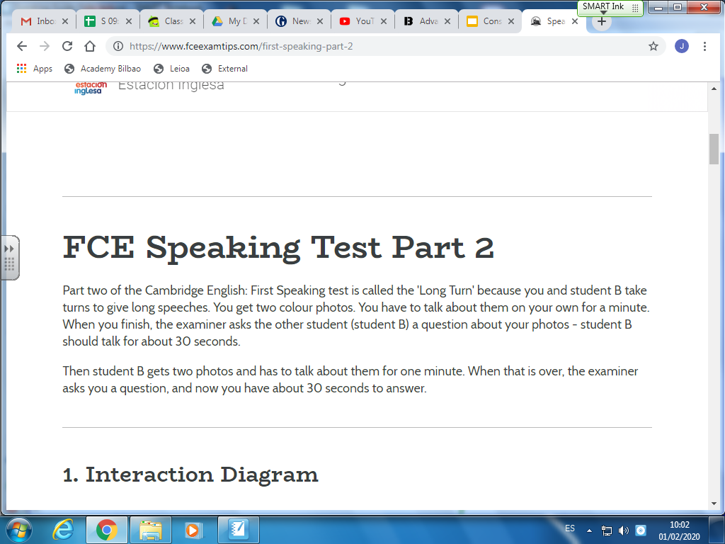
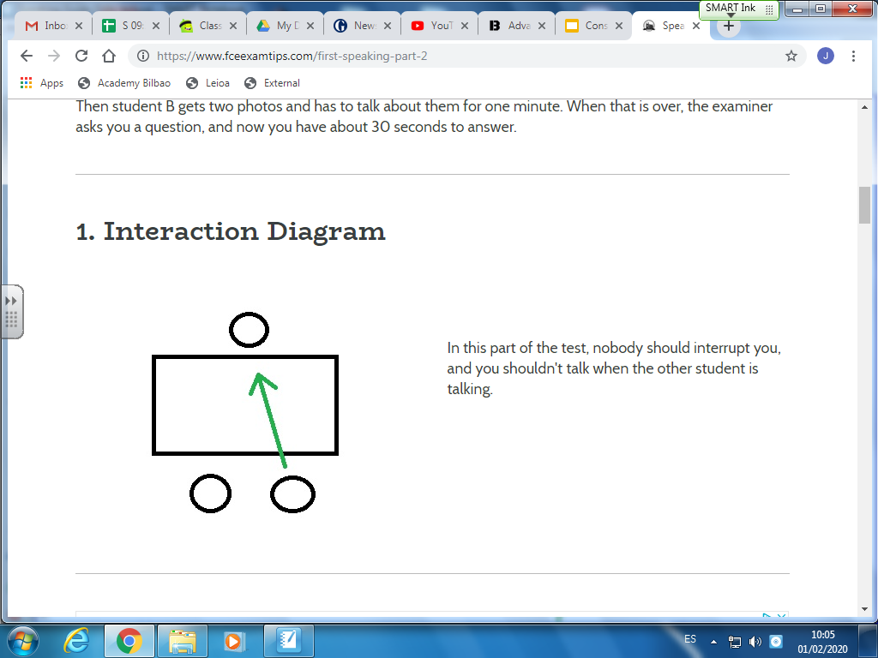
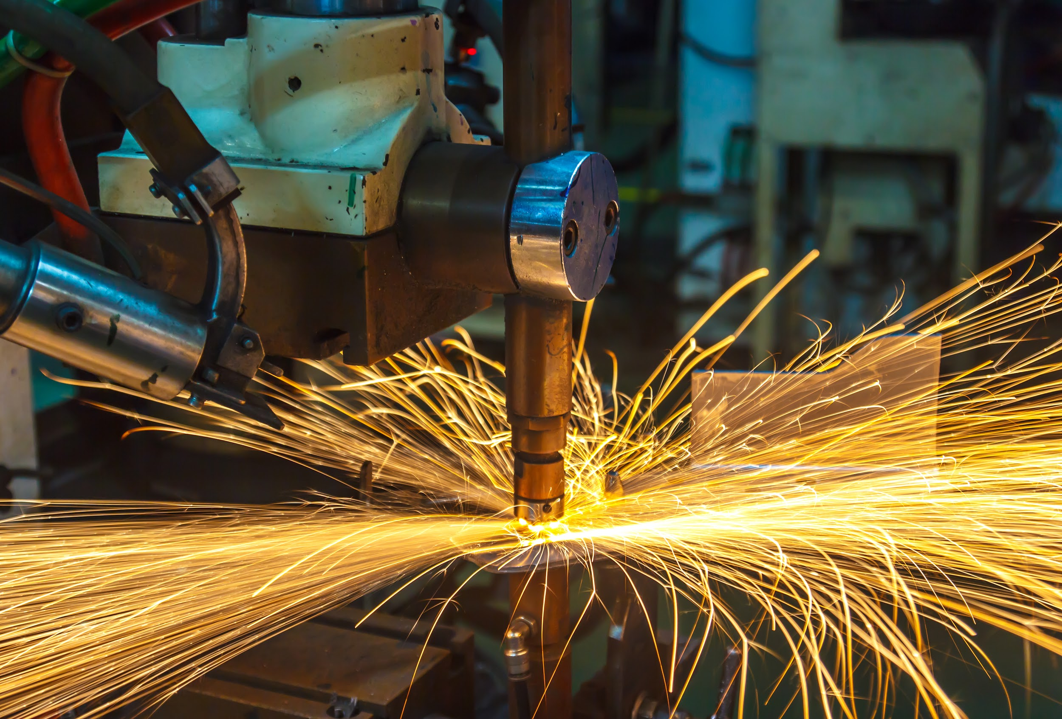
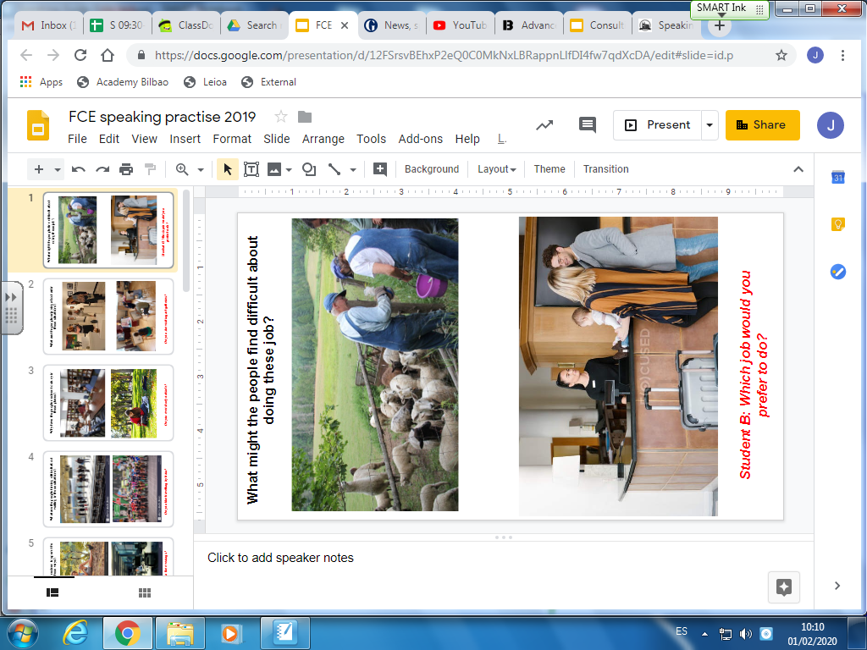
PART2
3 photos in CAE and 2 questions

Slide 6
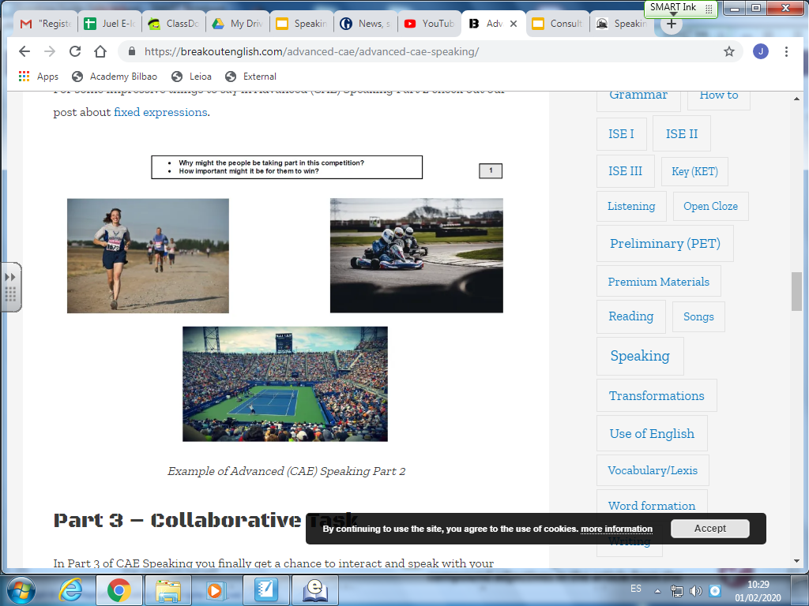
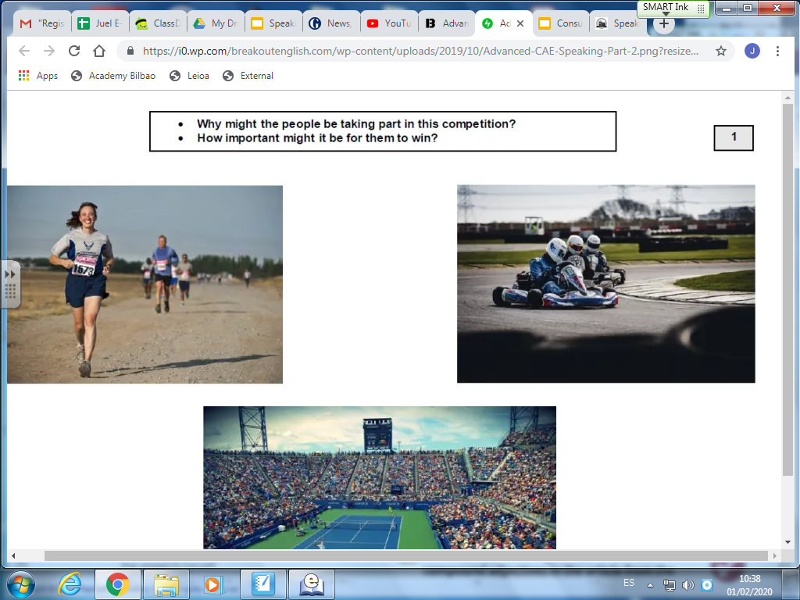
STRUCTURE
In the first picture we can see WHAT APPEARS TO Be ………
WHEREAS
Over here this LOOKS LIKE……..
BOTH pictures show……….
In the first ONE ……
ON THE OTHER HAND
In this one…..
Speculation and variety of Vocabulary
Contrast
Something very similar
Something very different
CAE
Avoiding repetition
Use second conditional to express preference
Well, I guess , if I had to choose I would probably GO FOR ….
Mainly because…… ( give at least 2 reasons)

Slide 7
Example
DONT MEMORISE THIS IS JUST FOR IDEAS.
In the first picture we can see WHAT APPEARS TO BE people working with sheep probably on a farm WHEREAS over here this LOOKS LIKE a hotel receptionist checking a family in.
BOTH pictures show very different working environments.
In the first ONE working with animals is always incredibly challenging. It is not always easy to predict how they will behave.
ON THE OTHER HAND although I get the impression that the job of a receptionist is slightly easier it can still be hard work especially if you have to deal with demanding or complaining clients.
In the first picture i imagine that you would have to wake up at dawn maybe 5 in the morning for me that would be the most difficult part of the job WHILE in the second photo customers are sometimes really rude and i think thats what makes her job hard.
Blah blah blah…..

Slide 8
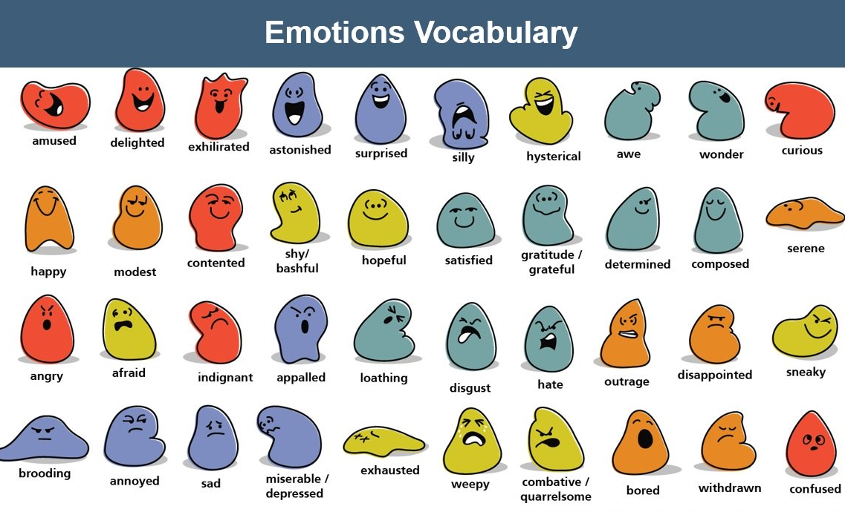
In the CAE speaking exam the second question is very often
How are the people feeling?
As such it's very important to pick up vocab, please don't use vocab like ´happy ´or ´sad´

Slide 9
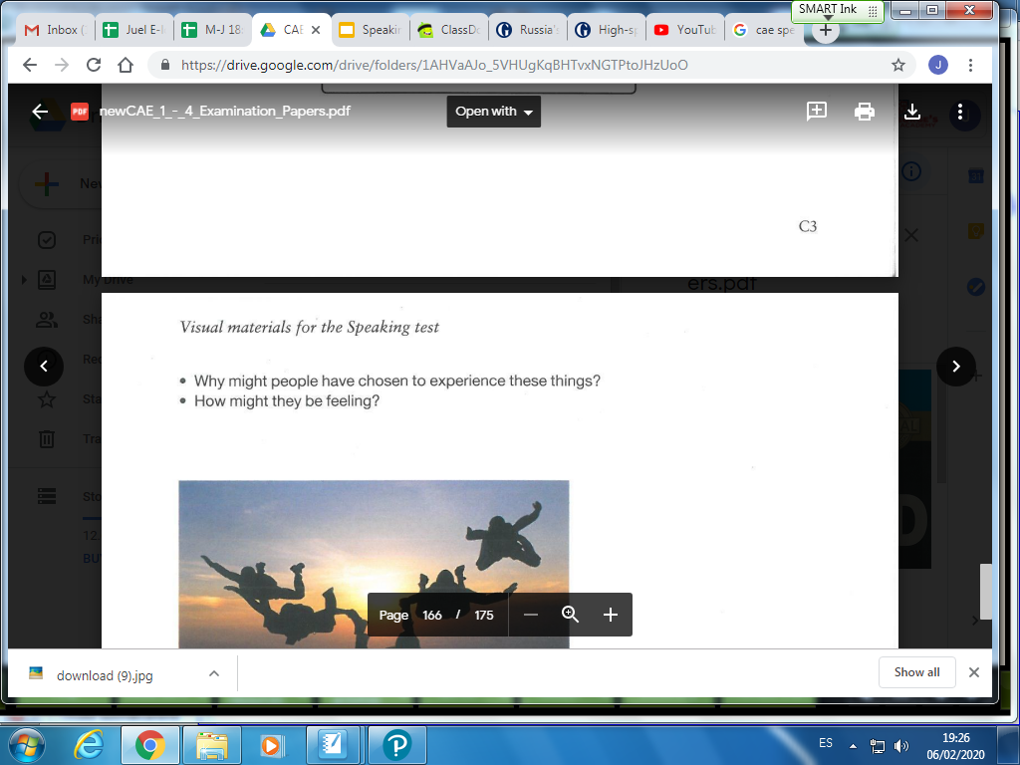
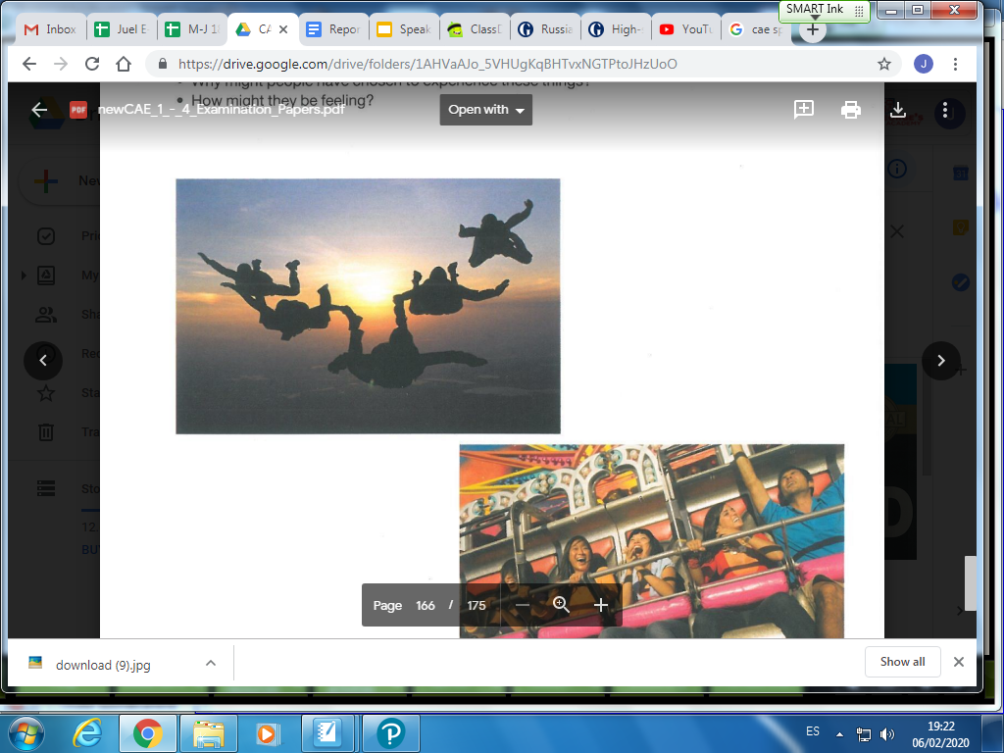
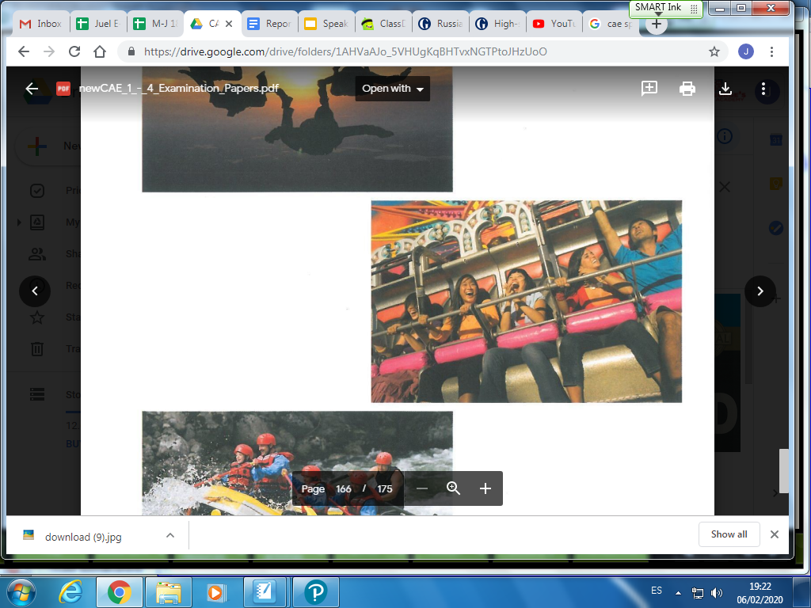
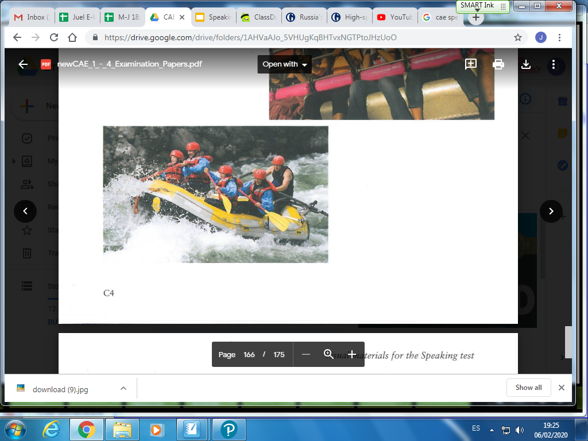
Have a go
CAE

Slide 10
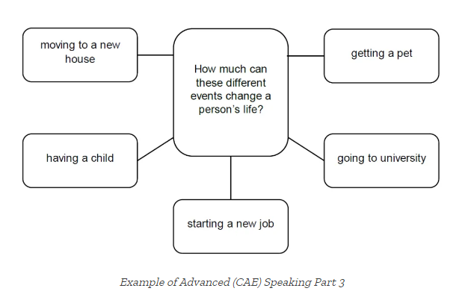
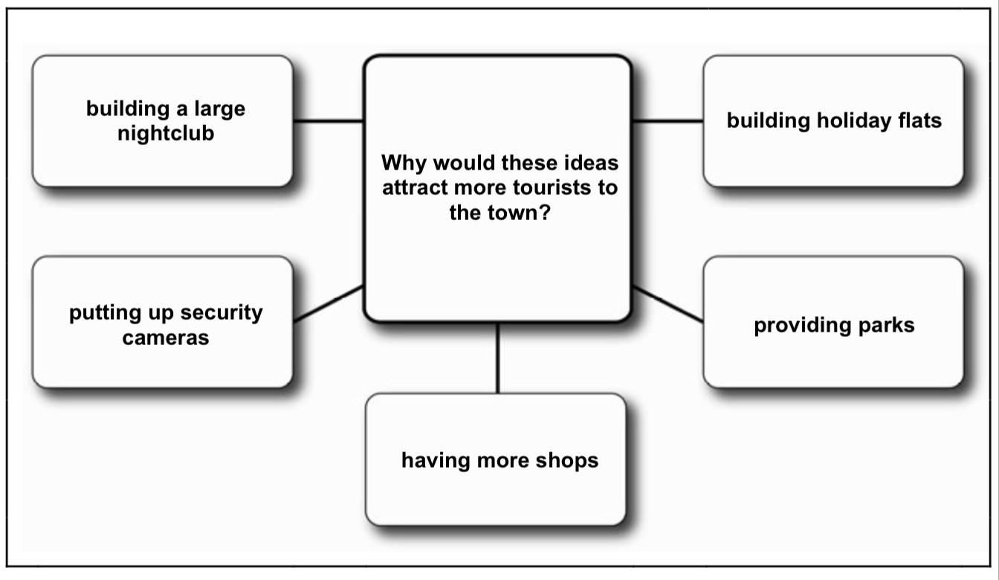
LANGUAGE
You will also need to ask for opinion (for interactive Communication points)
Wouldn't you agree? Don´t you think so? How about you (pablo)?
PART 3
Let's start with some functional English to begin with
Would you like to start? Shall I start? Let's start with…. Shall we start with this one….?
Use persons name it sounds friendlier
To change from one topic to the next or another one
How about this one? Let's move on to… Shall we talk about this now?
What about this one?
CAE
FCE

Slide 11
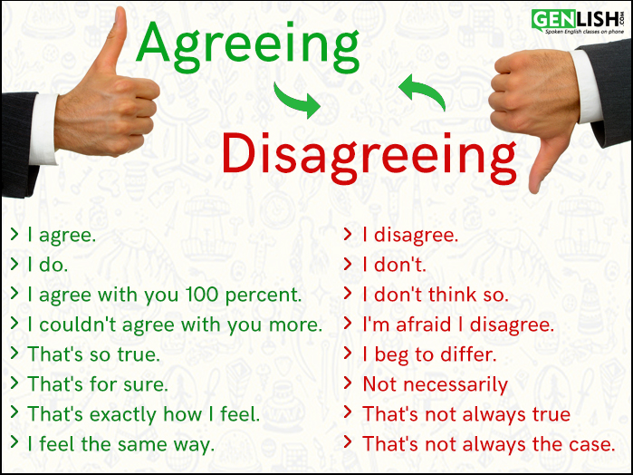
Agreement/Disagreement
AGREEMENT
I agree
Absolutely
That's so true
I couldn't agree with you more
You´re absolutely right
That's exactly how I feel
Yes, no doubt about it.
I was just about to say that
DISAGREEMENT
disagree/ don't agree
That's not quite the way I see it
PARTIAL AGREEMENT
I can't argue with that but….
I agree up to a point

Slide 12
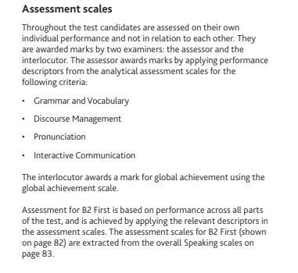
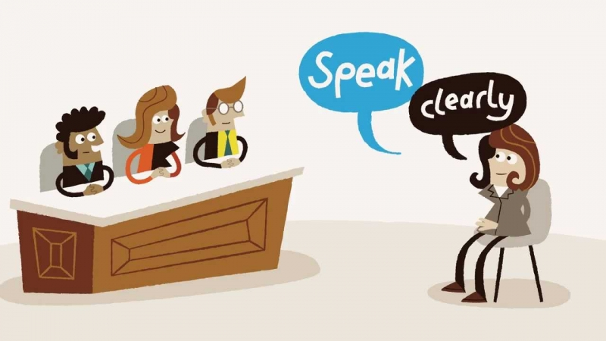
MARKING
5 MARKS for each part
In CAE Grammar and Vocabulary marked separately

Slide 13

MARKING
Pronunciation;
Be intelligible (hopefully the examiner will understand you) Pronounce individual words correctly eg, comfortable, vegetable, parent etc. but also sentence stress (basically try not to sound like a robot)
Discourse Management:
This is how much fluency you have, little hesitation will get you better marks. Did you use all the time available to you? Is what you are saying relevant? Good use of linkers to organize your speech and ideas.
Grammar /Vocabulary:
AS the title suggests did you use a wide range of vocabulary to talk about a variety of topics? Complex grammatical forms will also get you marks. For example A second conditional is considered complex grammatical form. Able to give and exchange opinion and views.
Interactive Communication:
Initiate and respond appropriately, build on information that other student has given. Asks questions, shows interest, actively reaching a decision in part 3.
Remember 5 marks for each of these.

Slide 14
Last Minute Advice
PART2
1
In Part 2 many FCE students describe the photos. Nobody asked you to describe them! You are asked to compare - there's a big difference.
Describing has ONE element - This man is riding a bike. Comparing has TWO elements - This picture shows a man riding a bike while this one shows a motorbike.
treat your partner like an EQUAL - give them equal chance to speak and be prepared to agree and disagree with them in a respectful way
think of it is like a tennis practice - you hit the ball to your partner with the goal of playing for as long as possible.
You will get a good grade if you ask questions and react to what the other student says.
You will get a bad grade if you are selfish, don't listen, or try to monopolise the conversation
There are no right or wrong answers, only good or bad discussions. If you disagree, explain why. Try to persuade your partner that your way is right. But also, when your partner says something good, react. 'Oh, that's a good point, I hadn't thought of that.'
Cambridge are only interested in the quality of the discussion and the quality of your language (your grammar and vocabulary). You won't lose points if you say something crazy like: ¨We all need a president like Donald Trump´
3
2

Slide 15
Last Minute Advice
PART3
In Part 3 Say a couple of sentences then ask a question. Never answer your own questions!
Try to look at your speaking partner more than the paper or the examiner
Some students turn their chair a little bit - towards the other student. This helps them to remember who they should talk to.
If your speaking partner is talking about the wrong thing, bring them back to the task. Say, 'that's very interesting but we should talk about why more tourists would come'.
8
In part 3 decision making DON'T start by saying what you think is the most important!
This may seem crazy at first, but look:
- I think providing parks will bring the most tourists because they will have a place to relax, especially in Summer.
- I totally agree.
END CONVERSATION
There's another 45 seconds left! What are you going to discuss? Nothing useful, that's for sure!
Lastly SMILE be ENTHUSIASTIC it could be worth 10% more just for that.
4
5
6
7
9

Slide 16
Thank you.

